Slide 1

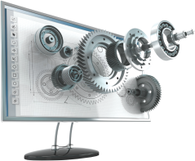
Microsoft Azure AI Fundamentals
Archer Infotech , PUNE
www.archerinfotech.in

Slide 2
Microsoft Azure AI

Slide 3
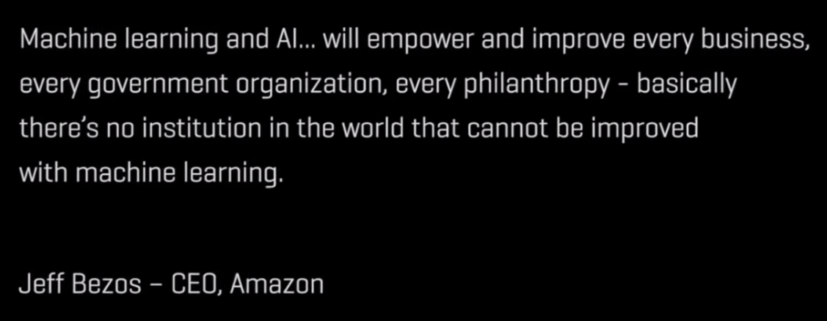

Slide 4
What is Artificial Intelligence ?
Google search
Search engines couldn’t scan the entire internet and deliver what you want without the assistance of artificial intelligence. Those ads that seem to follow you around? Yep, those are enabled by AI, are based on your search history and are personalized to you with the goal of getting items in front of you that the algorithms believe you will value.
Open your phone with face ID
Apple’s FaceID can see in 3D. It lights up your face and places 30,000 invisible infrared dots on it and captures an image. It then uses machine learning algorithms to compare the scan of your face with what it has stored about your face to determine if the person trying to unlock the phone is you or not.
Apple states the chance of fooling FaceID is one in a million.

Slide 5
What is Artificial Intelligence ?
Social media
Not only is artificial intelligence working behind the scenes to personalize what you see on your feeds (because it's learned what types of posts most resonate with you based on past history), it's figuring out friend suggestions, identifying and filtering out fake news and machine learning is working to prevent cyberbullying.
Smart Home Devices
AI applications can be found in homes as well. Many smart home gadgets that we purchase utilize AI algorithms to get familiar with our conduct. They do so in order to learn from their environment and utilize this knowledge for the future, to make the user experience as frictionless as possible. The Voice Assistance devices that we use to control these nifty home gadgets are also Artificial Intelligence real life examples.

Slide 6
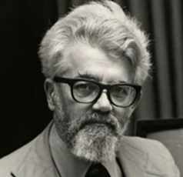

What is Artificial Intelligence ?
Artificial intelligence (AI) is a wide-ranging branch of computer science by which we can create intelligent machines which can behave like human , think like humans and able to make decisions
Artificial Intelligence is composed of two words Artificial and Intelligence, where Artificial defines "man-made," and intelligence defines "thinking power", hence AI means "a man-made thinking power."

Slide 7
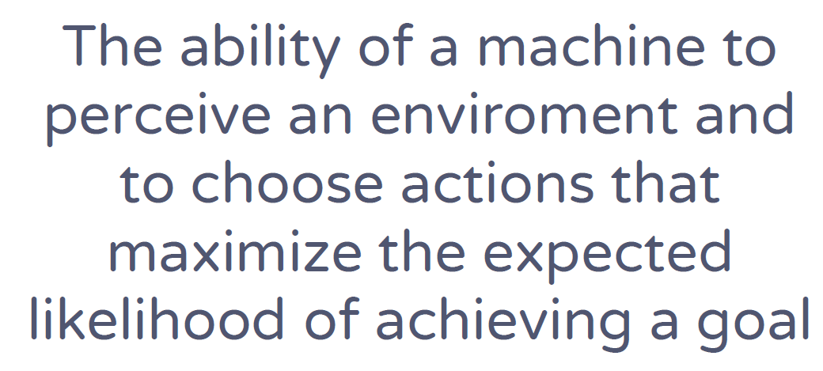
What is Artificial Intelligence ?

Slide 8

Demand for AI

Slide 9
AI Examples
Siri, Alexa and other smart assistants
Self-driving cars
Robo-advisors
Conversational bots
Email spam filters
Netflix's recommendations
Google Maps
Online Ads Network
Music and Media Streaming Services
Image Editing — Remove Background & Enhance Resolution

Slide 10
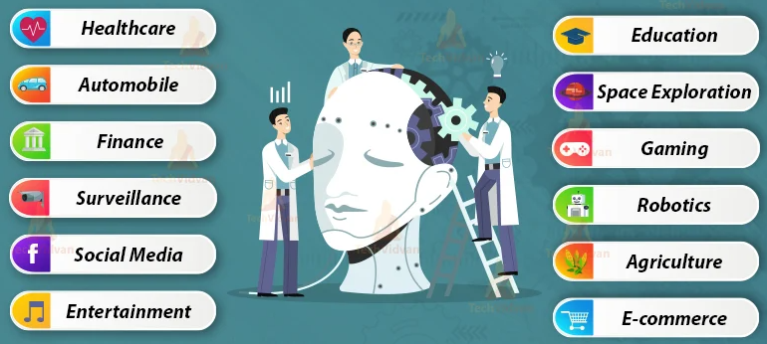
AI Applications

Slide 11
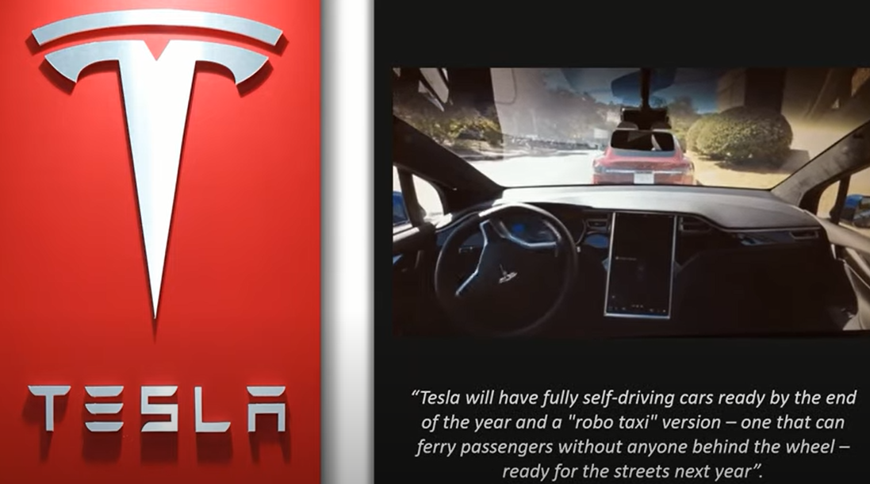
AI Automobile Application

Slide 12
AI Finance & Banking Applications
Security of our transactions and to detect fraud
Chatbots offered by banks
Mobile Check Deposits
Ventures have been relying on computers and data scientists to determine future patterns in the market. Trading mainly depends on the ability to predict the future accurately.

Slide 13
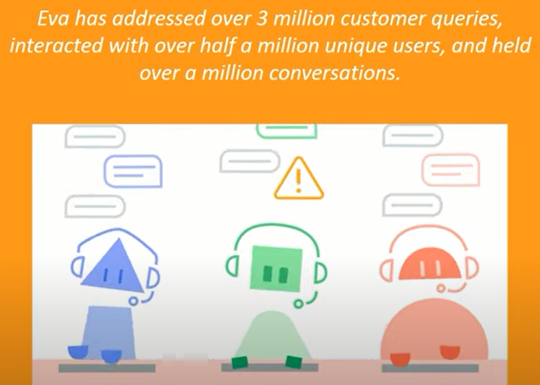


AI Banking Application

Slide 14
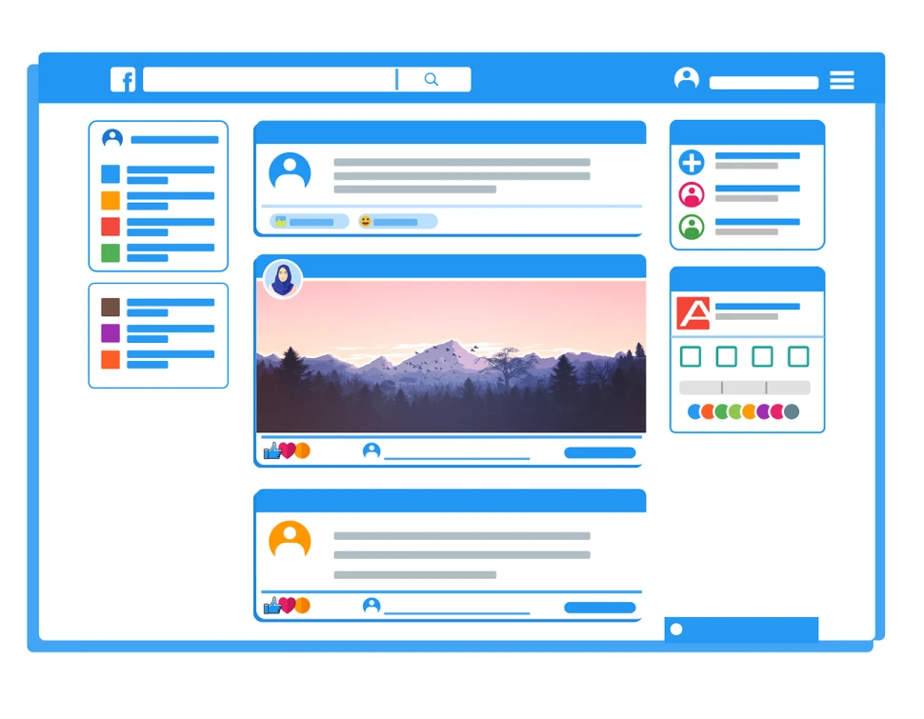
AI in Social Media
Social media platforms such as Facebook, Twitter, and Instagram rely heavily on artificial intelligence for various tasks.
Also, researchers trained AI models to recognize hate keywords, phrases, and symbols in different languages. That way, the algorithm can swiftly take down social media posts that contain hate speech.
Other examples of artificial intelligence in social media include:
Emoji as part of predictive text
Facial recognition to automatically tag friends in photos
Smart filter to identify and remove spam messages
Smart replies for quickly responding to messages

Slide 15
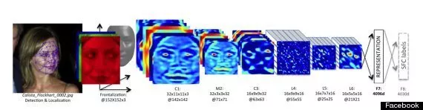
AI in Social Media
Social media applications are using the support of AI to monitor content, suggest connections, and serve advertisements to targeted users, among many other tasks to ensure that you stay invested and “plugged in”.
Facebook
Facebook uses AI to recognize faces. The company has invested heavily in this area not only within Facebook, but also through the acquisitions of facial-recognition startups like Face.com, which Facebook acquired in 2012 for a rumored $60M

Slide 16
AI Applications
Gaming : AI has also been playing a huge role in creating video games and making it more tailored to players’ preferences.
Robotics : With increasing developments within the field of AI, robots are becoming more efficient in performing tasks that earlier were too complex.
Agriculture
Artificial Intelligence is changing the way we do one among our most primitive and basic professions which is farming.
The use of AI in agriculture are often attributed to agriculture robots, predictive analysis, and crop and soil monitoring.
In addition, drones are also used for spraying insecticides and detecting weed formation in large farms. AI has also enhanced crop production and improved real-time monitoring, harvesting, processing and marketing.
Education : Automated marking software, content retention techniques and suggesting improvements that are require

Slide 17

AI in Online Shopping
The retailer’s AI algorithms learned what you like and what other people who are like you purchased to deliver to your Amazon feed recommendations for what you might like in your carts. Amazon is so confident in its predictive analytics and algorithms that it will ship products towards you even before you “click to buy” with its anticipatory shipping algorithm.
1 –Search
2 –Recommendations

Slide 18
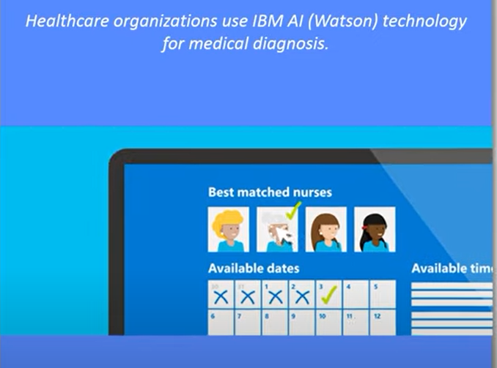

Top AI Applications

Slide 19
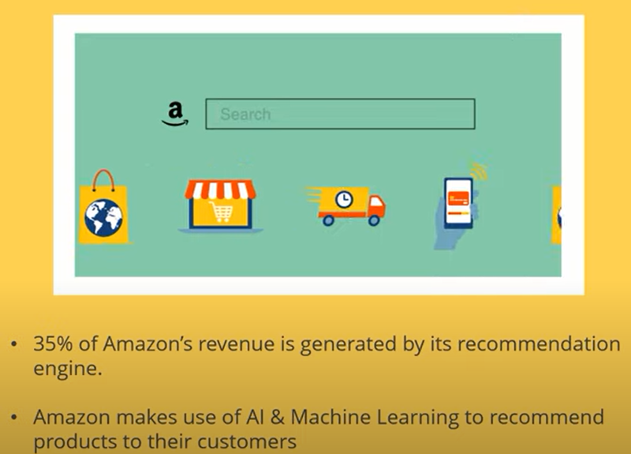

Top AI Applications

Slide 20

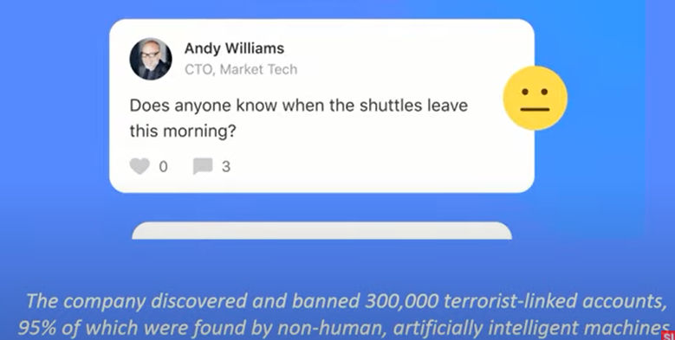
Top AI Applications

Slide 21
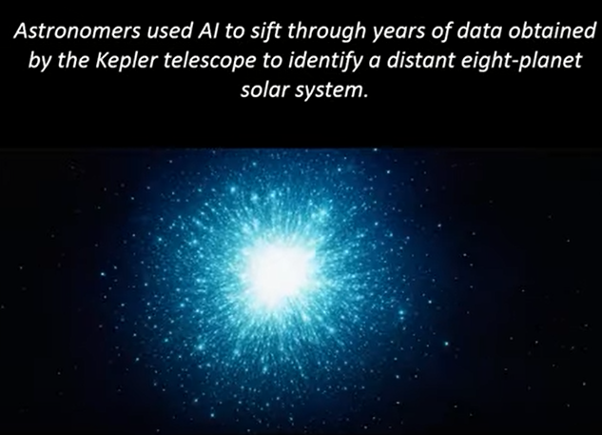

Top AI Applications

Slide 22
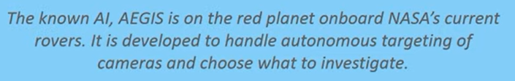
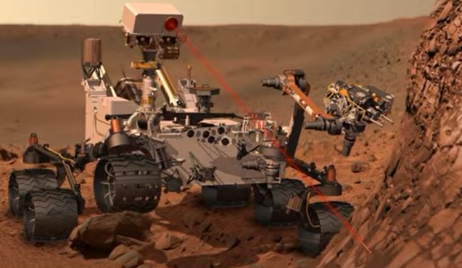

Top AI Applications

Slide 23
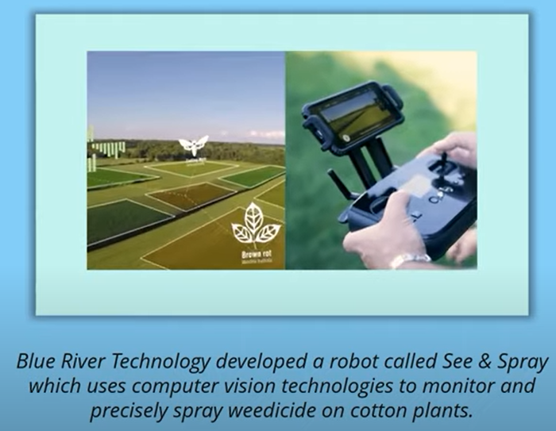


Top AI Applications

Slide 24
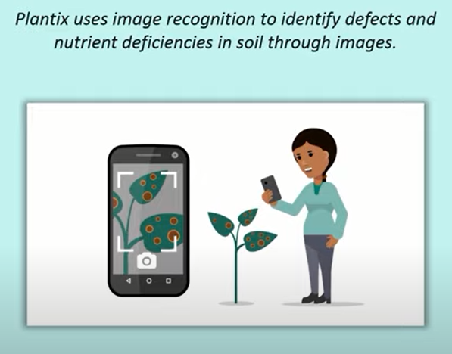

Top AI Applications

Slide 25
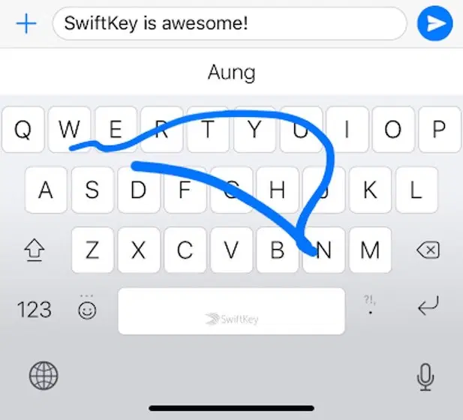
AI in Daily Life – Smart Keyboards
The smart keyboard apps keep a tab on the writing style of a user and predict words and emojis accordingly.
Thus, typing on the touchscreen has become faster and more convenient.
Not to mention, artificial intelligence also plays a vital role in pinpointing misspellings and typos.

Slide 26
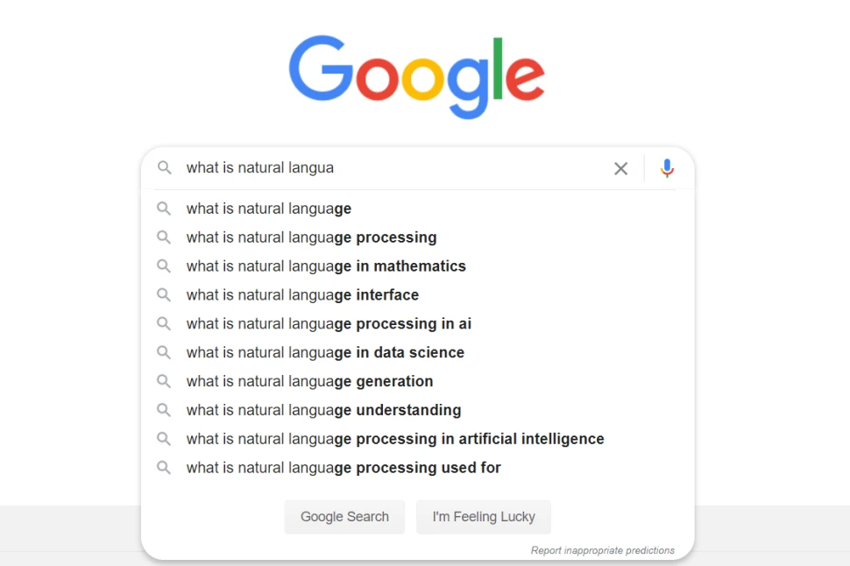
AI in Daily Life – Search Algorithms
Search algorithms ensure that the top results on the search engine result page (SERP) have the answers to our queries
Last year, Google announced Bidirectional Encoder Representations from Transformers (BERT), an NLP pre-training technique. Now, the technology powers almost all English-based query on Google Search.

Slide 27

AI in Daily Life – Digital Assistances
In October 2011, Apple’s Siri became the first digital assistant to be standard on a smartphone. However, voice assistants have come a long way since then.
Today, Google Assistant incorporates advanced NLP and ML to become well-versed in human language. Not only does it understand complex commands, but it also provides satisfactory outputs.

Slide 28
AI in Daily Life – Smart Home Devices
Various smart home devices now use AI applications to conserve energy.
For example, smart thermostats such as Nest use our daily habits and heating/cooling preferences to adjust home temperatures. Likewise, smart refrigerators can create shopping lists based on what’s absent on the fridge’s shelves.
The way we use artificial intelligence at home is still evolving. More AI solutions now analyze human behavior and function accordingly.

Slide 29

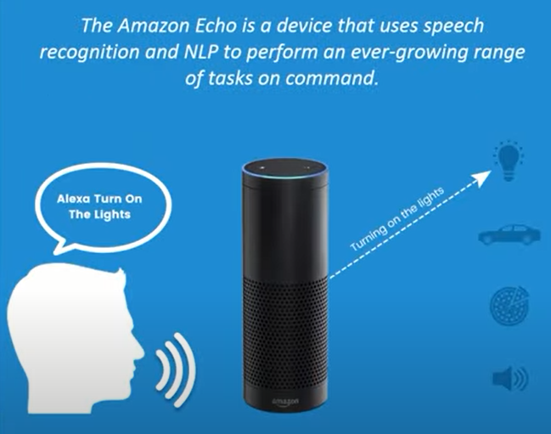
Top AI Applications

Slide 30

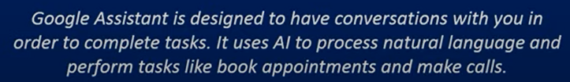
Top AI Applications

Slide 31
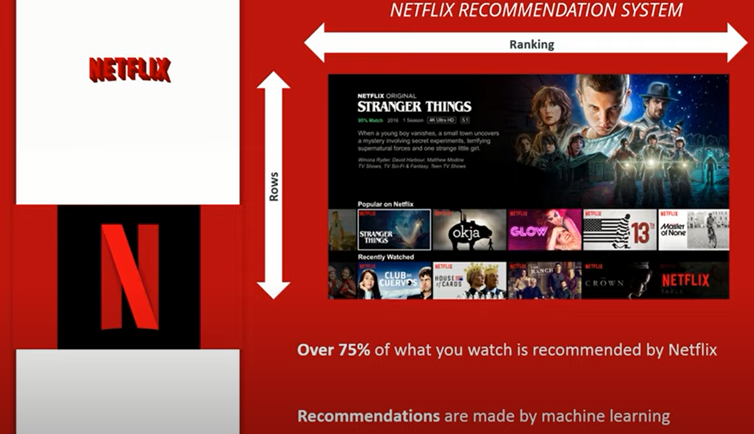
Top AI Applications

Slide 32
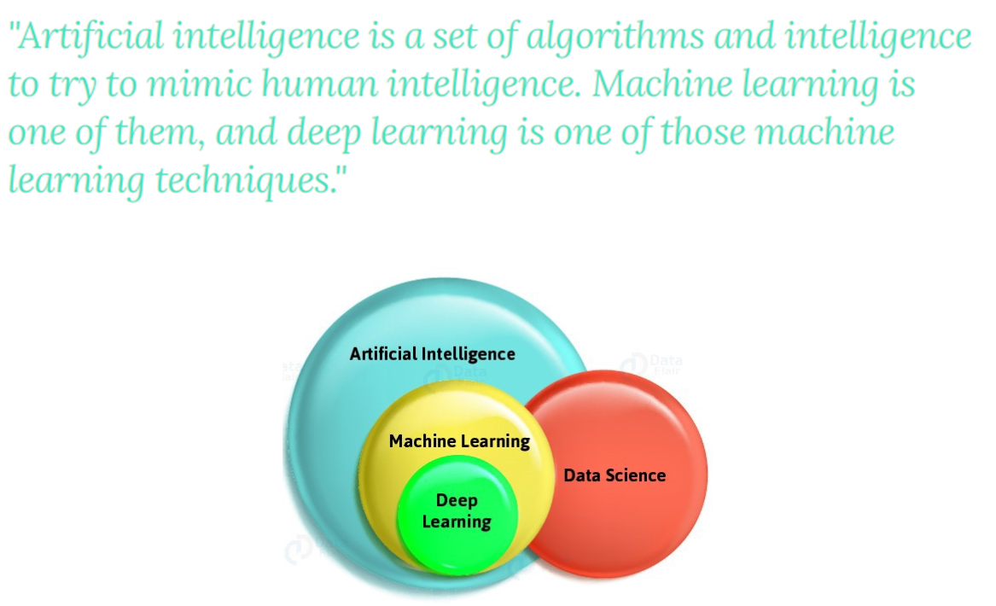
What is Artificial Intelligence ?

Slide 33
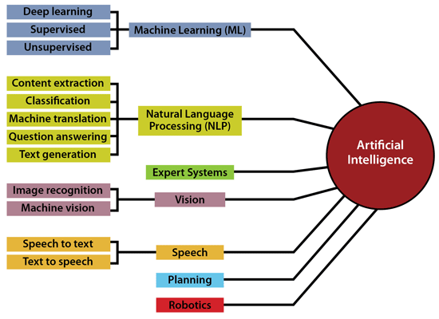
Artificial Intelligence Characteristics

Slide 34
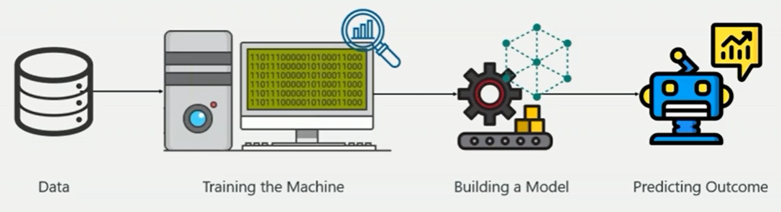
Machine Learning
Machine Learning is a subset of Artificial Intelligence (AI) which provides machines the ability to learn automatically & improve from experience without being explicitly programmed

Slide 35
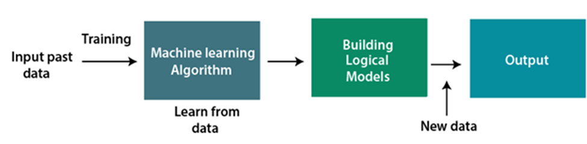
How Machine Learning Works ?
A Machine Learning system learns from historical data, builds the prediction models, and whenever it receives new data, predicts the output for it. The accuracy of predicted output depends upon the amount of data, as the huge amount of data helps to build a better model which predicts the output more accurately

Slide 36
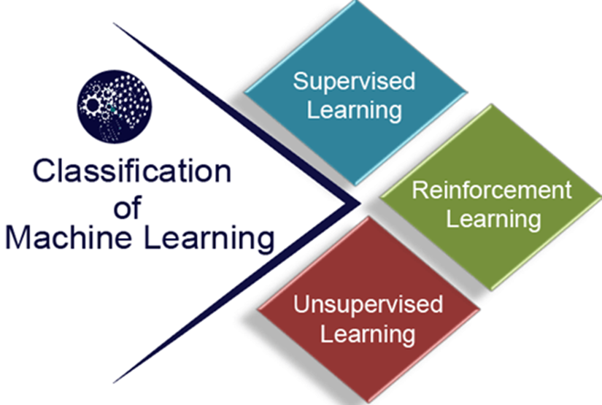
Types of Machine Learning

Slide 37
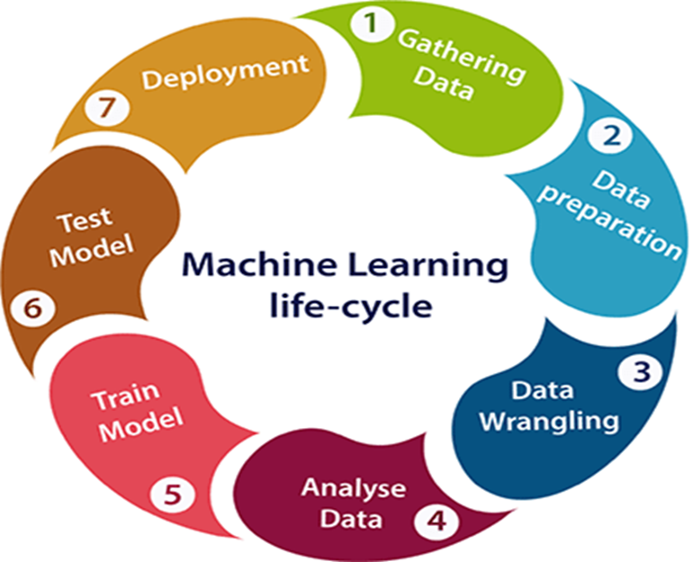
Machine Learning Life Cycle

Slide 38
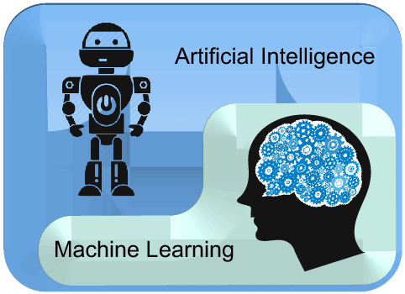
Difference between AI & ML
AI is a bigger concept to create intelligent machines that can simulate human thinking capability and behavior, whereas, machine learning is an application or subset of AI that allows machines to learn from data without being programmed explicitly.

Slide 39
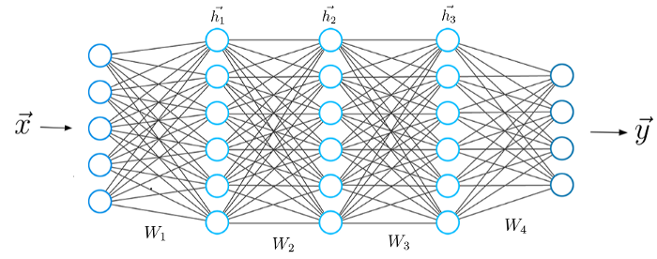
What is Deep Learning ?
Deep Learning is a subset of Machine Learning, which on the other hand is a subset of Artificial Intelligence.
Deep Learning is just a type of Machine Learning, inspired by the structure of a human brain. Deep learning algorithms attempt to draw similar conclusions as humans would by continually analyzing data with a given logical structure. To achieve this, deep learning uses a multi-layered structure of algorithms called neural networks

Slide 40
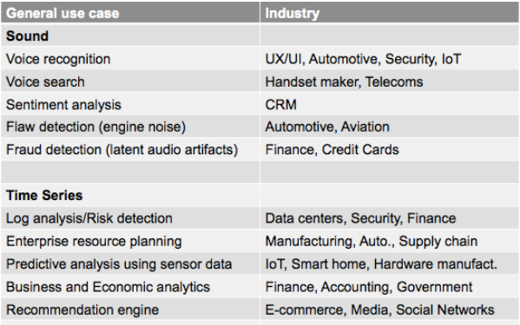
Deep Learning Use Cases

Slide 41
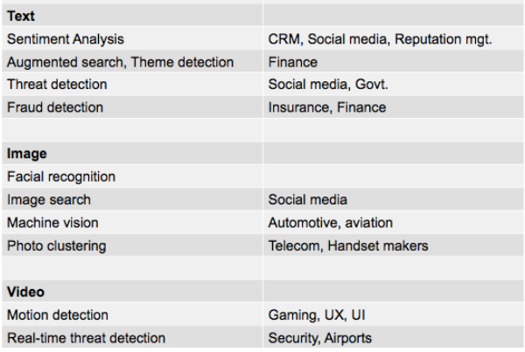
Deep Learning Use Cases

Slide 42
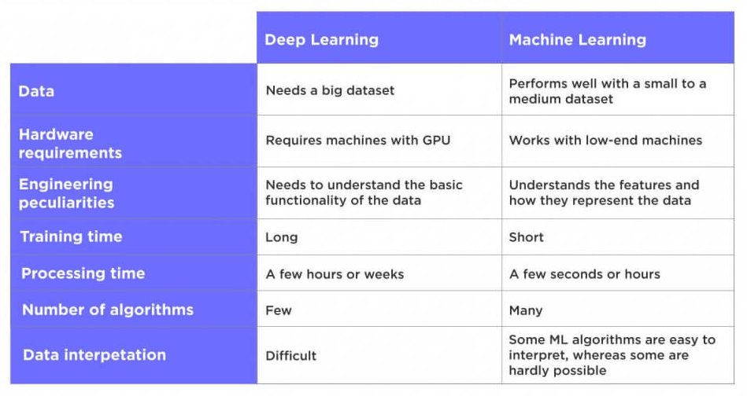
Deep Learning Vs. Machine Learning

Slide 43
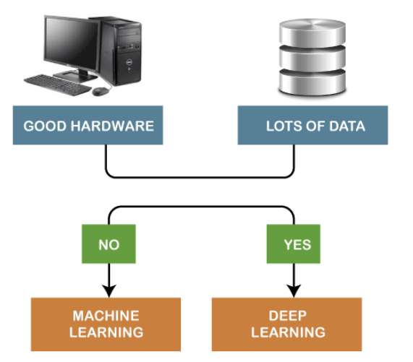
Which one to Select ?

Slide 44
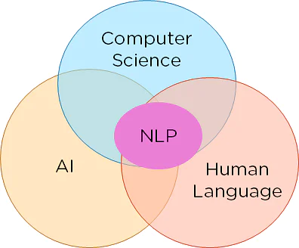
What is NLP ?
NLP stands for Natural Language Processing, which is a part of Computer Science, Human language, and Artificial Intelligence.
It is the technology that is used by machines to understand, analyze, manipulate, and interpret human's languages.
It helps developers to organize knowledge for performing tasks such as translation, automatic summarization, Named Entity Recognition (NER), speech recognition, relationship extraction, and topic segmentation.

Slide 45
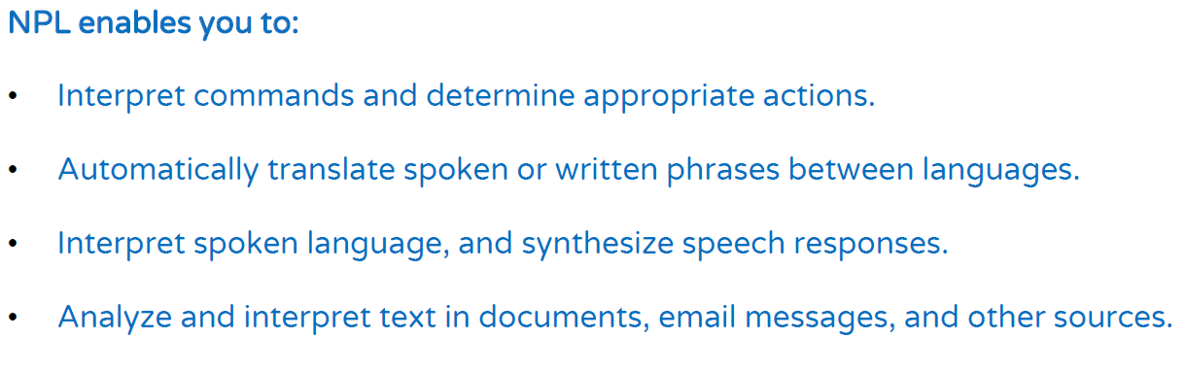
Natural Language Processing

Slide 46
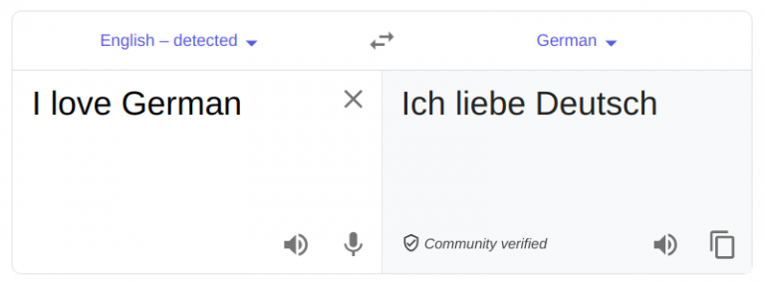
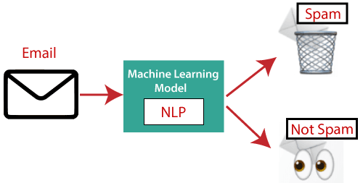
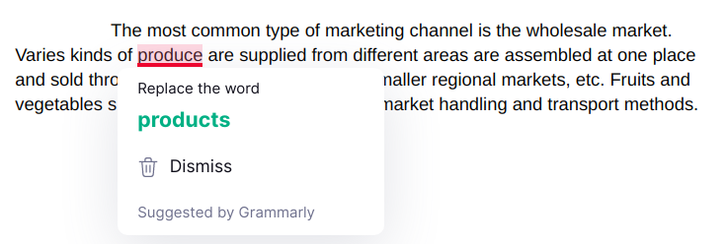

NLP Applications
Machine Translation
Spam Detection
Spelling correction
Sentiment Analysis

Slide 47
NLP Applications
Speech Recognition
Social Media Monitoring
Chatbots
Question Answering
Information extraction

Slide 48
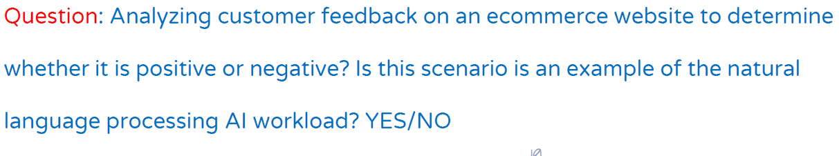
Natural Language Processing

Slide 49

What is Computer Vision ?
Computer vision is a field of artificial intelligence that trains computers to interpret and understand the visual world. Machines can accurately identify and locate objects then react to what they “see” using digital images from cameras, videos, and deep learning models.

Slide 50
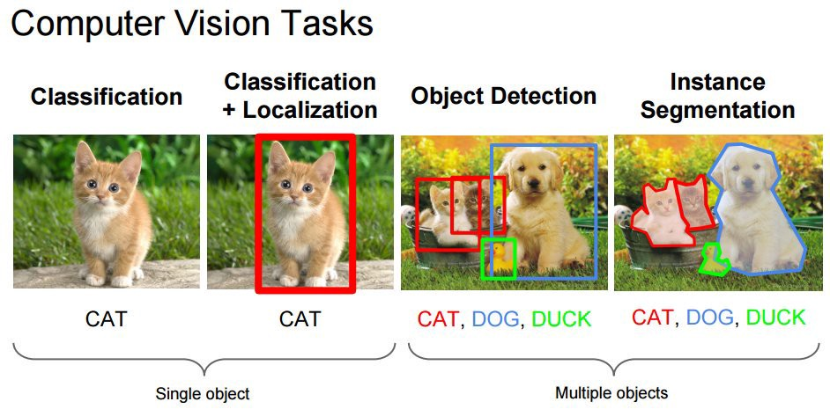
Common tasks of Computer Vision
Object classification. The system parses visual content and classifies the object on a photo/video to the defined category. For example, the system can find a dog among all objects in the image.
Object identification. The system parses visual content and identifies a particular object on a photo/video. For example, the system can find a specific dog among the dogs in the image.
Object tracking. The system processes video finds the object (or objects) that match search criteria and track its movement.

Slide 51
Computer Vision Applications
Face recognition - Snapchat, Instagram, Facebook and many other social media apps use face-detection algorithms to recognize you in pictures and apply filters on your face.
Surveillance - Surveillance cameras use computer vision to help detect suspicious behavior in public and private locations.
Image retrieval - Google Images help you find relevant images when you upload an image. There are different algorithms that analyze the content in the image uploaded and return results based on the best-matched content.
Biometrics - Fingerprint and iris recognition are some common methods in biometric identification that uses computer vision.
Smart cars - Smart cars use computer vision to detect traffic signs and lights and other visual features when the cars go on auto mode.

Slide 52
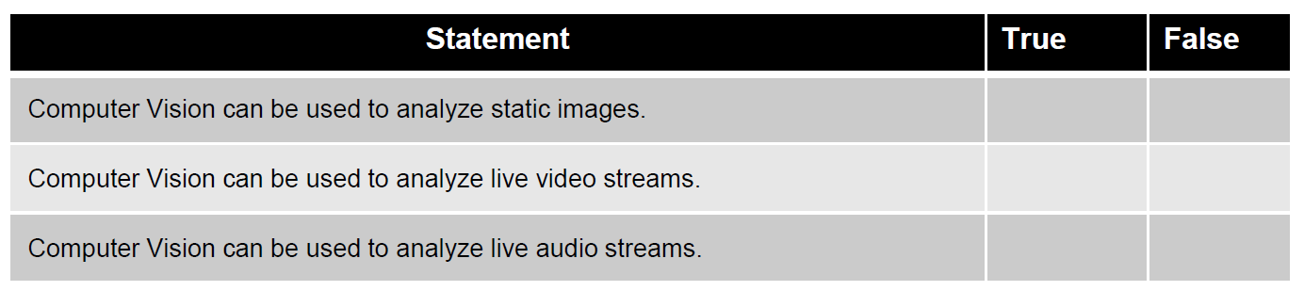
Computer Vision

Slide 53
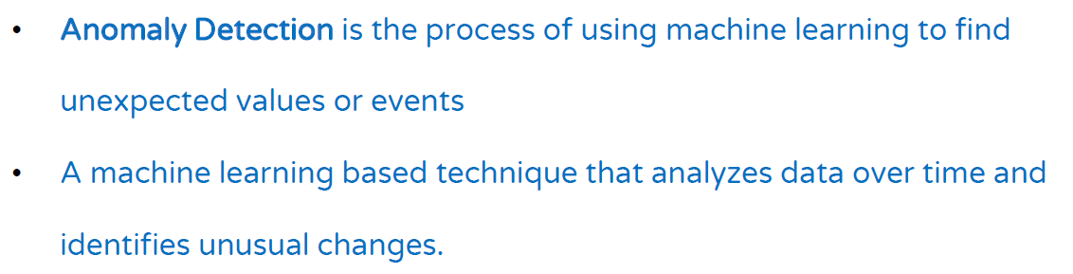
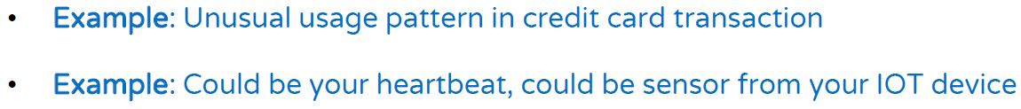

Anomaly Detection

Slide 54
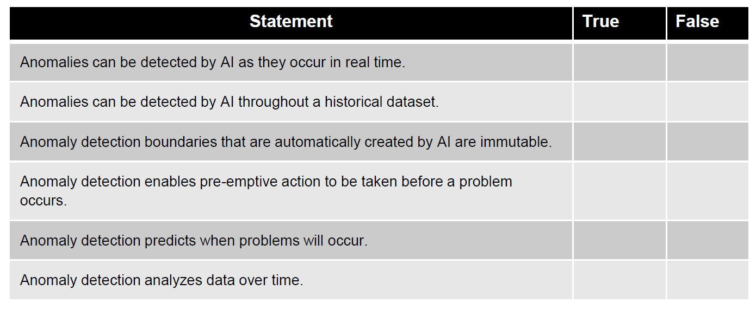
Anomaly Detection

Slide 55
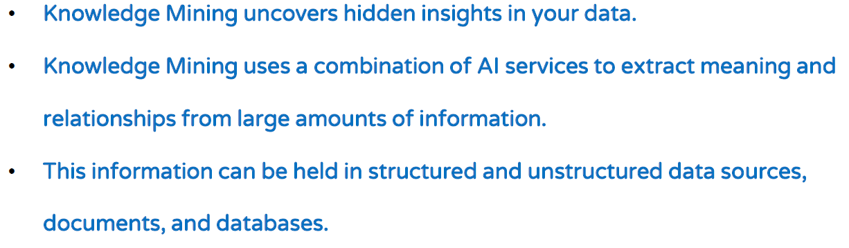
Knowledge Mining
Knowledge mining is the term used to describe solutions that involve extracting information from large volumes of often unstructured data to create a searchable knowledge store

Slide 56
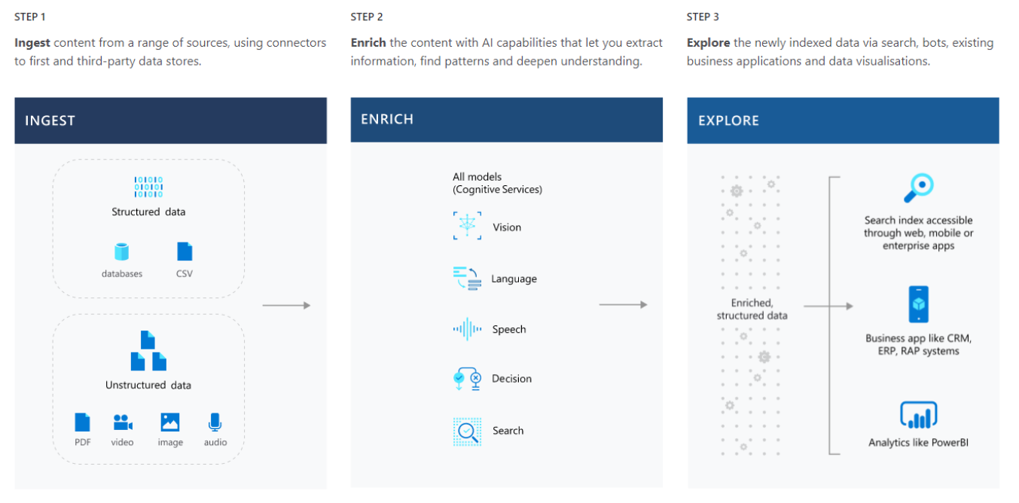
Knowledge Mining

Slide 57
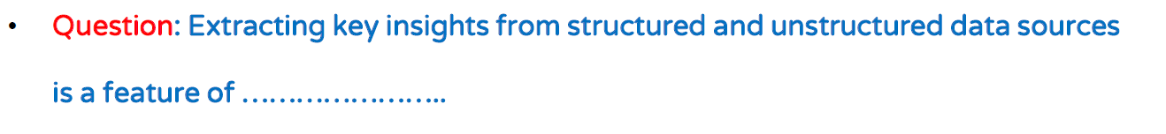
Knowledge Mining

Slide 58
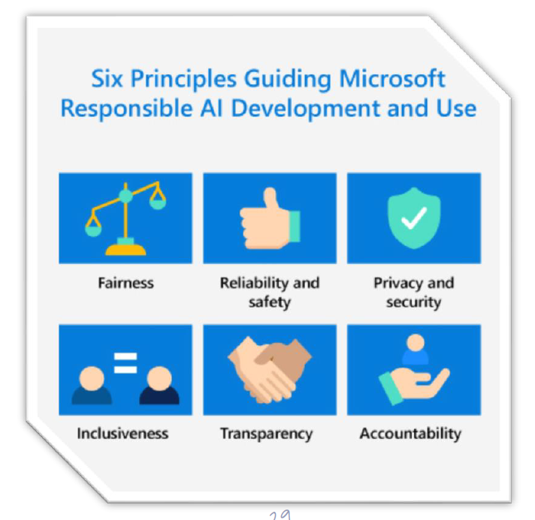
Guiding Principles of Responsible AI

Slide 59
Fairness
AI systems should treat all people fairly without incorporating any bias based on gender, ethnicity, or other factors that might result in an unfair advantage or disadvantage to specific groups of applicants.
Examples :
Bank Loan Approval Application
Medical Treatment
Employment
How to Design ?
Developers should use training datasets that reflect the diversity of society.
Developers should also design AI models in ways that allow them to learn and adapt over time without developing biases.

Slide 60
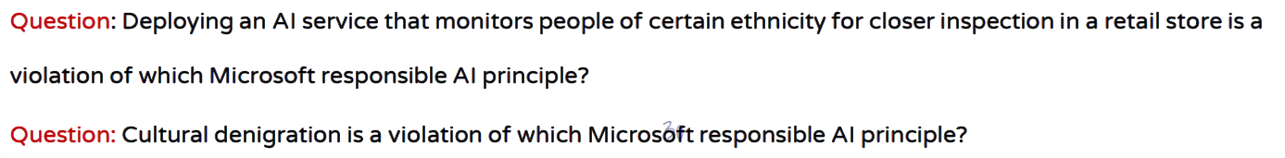
Fairness

Slide 61
Reliability & Safety
AI systems should operate reliably, safely, and consistently.
Ensure that AI systems operate as they were originally designed, respond to unanticipated conditions and resist harmful manipulations.
How does the military unmanned drone operate when the GPS is down?
Unexpected Conditions
How does the self-driving car operate at night? In a rainstorm? In a snowstorm?
Developer consideration?
Rigorous testing and deployment management processes
Operate, maintain, and protect their AI systems over the lifespan of their use

Slide 62
Reliability & Safety

Slide 63
Privacy & Security
AI systems should be secure and respect privacy.
Datasets may contain sensitive personal or business details that must be kept private
Many countries and regions in the world are developing new standards and laws to try to protect the data of its citizens
Provide consumers with information and controls over the collection, use and storage of their data
Developer consideration?
Robust compliance processes to ensure that data collected and used by our AI systems is handled responsibly.

Slide 64

Privacy & Security

Slide 65

Inclusiveness
Developer consideration?

Slide 66

Inclusiveness

Slide 67


Transparency

Slide 68


Accountability

Slide 69

Accountability

Slide 70

What is Data Science ?

Slide 71
THANK YOU !!!

